Slide 1
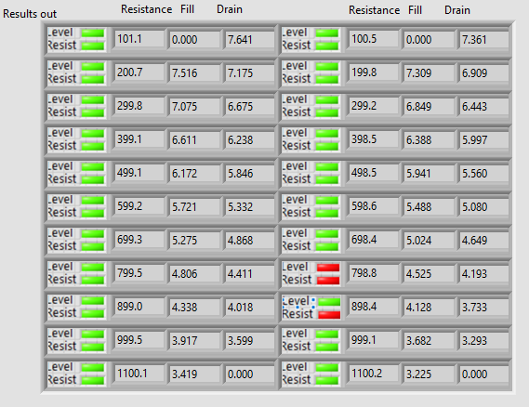
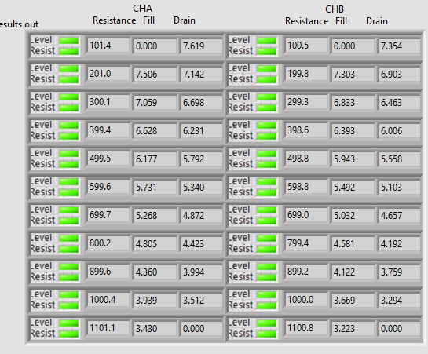
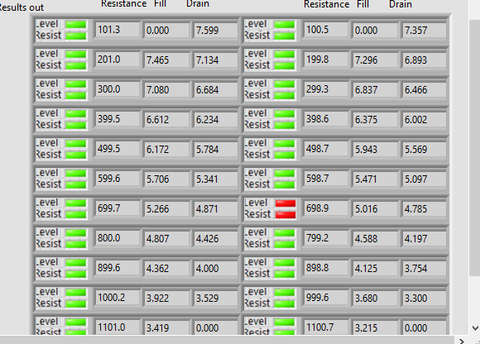
TU5 Run 1
TU5 Run 2
TU5 Run 3

Slide 2
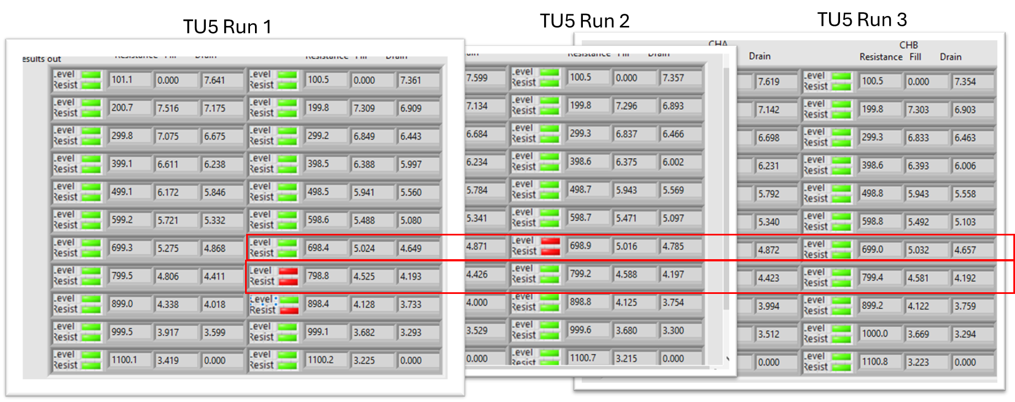
Bad
+0.060”
4.625-4.725
Bad
-0.010”
4.535-4.635

Slide 3
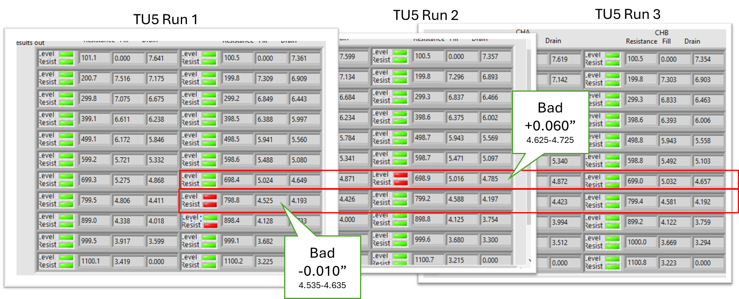

Slide 4
Descriptive Statistics

Slide 5
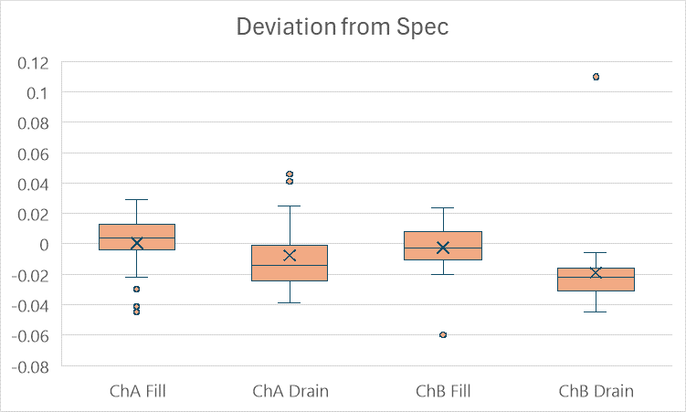
Box & Whisker Plot of Columns D1-3 of Descriptive Stats.
Bad
+0.060”
4.625-4.725
Outliers
USL
LSL
Outliers
Bad
-0.010”
4.535-4.635

Slide 6
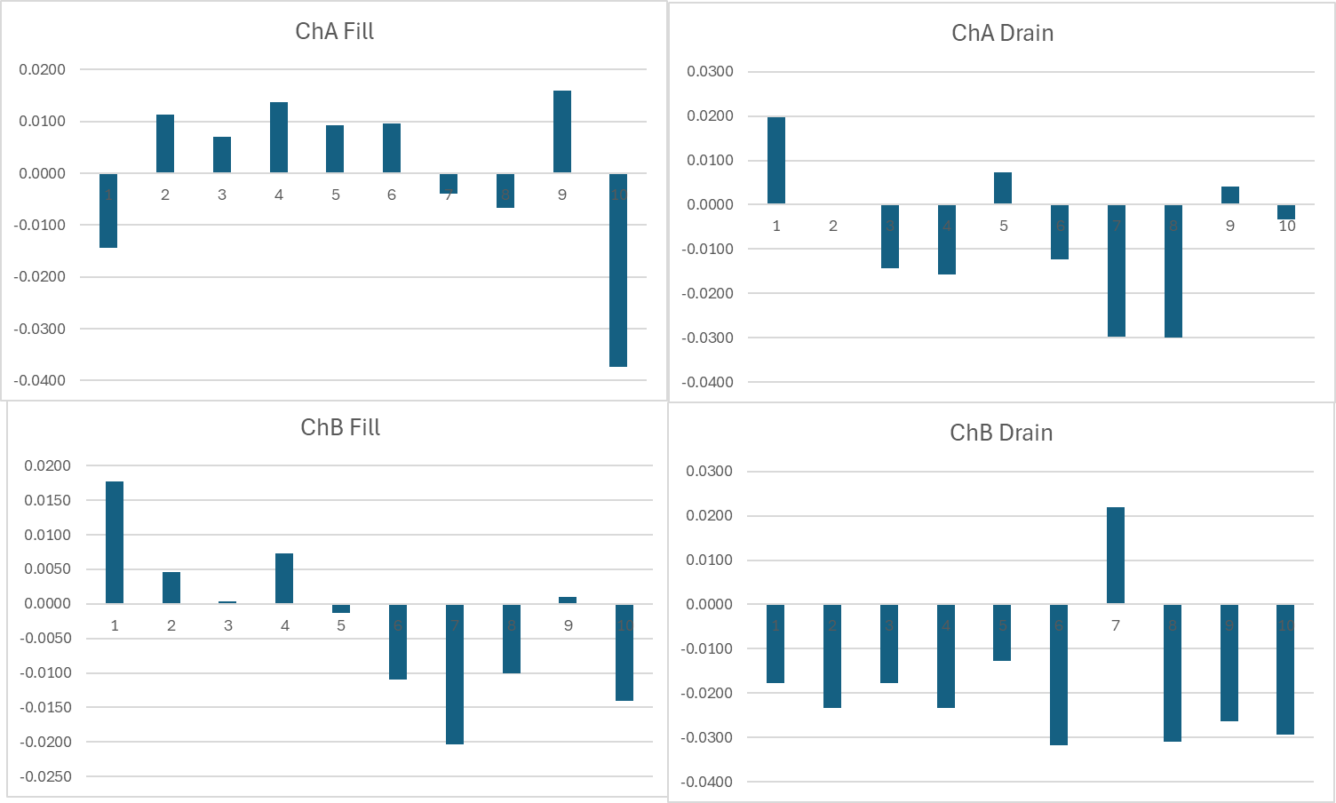
Each bar represent the deviation of three measurements average from spec for each reed switch in TU5

Slide 7
